Slide 1
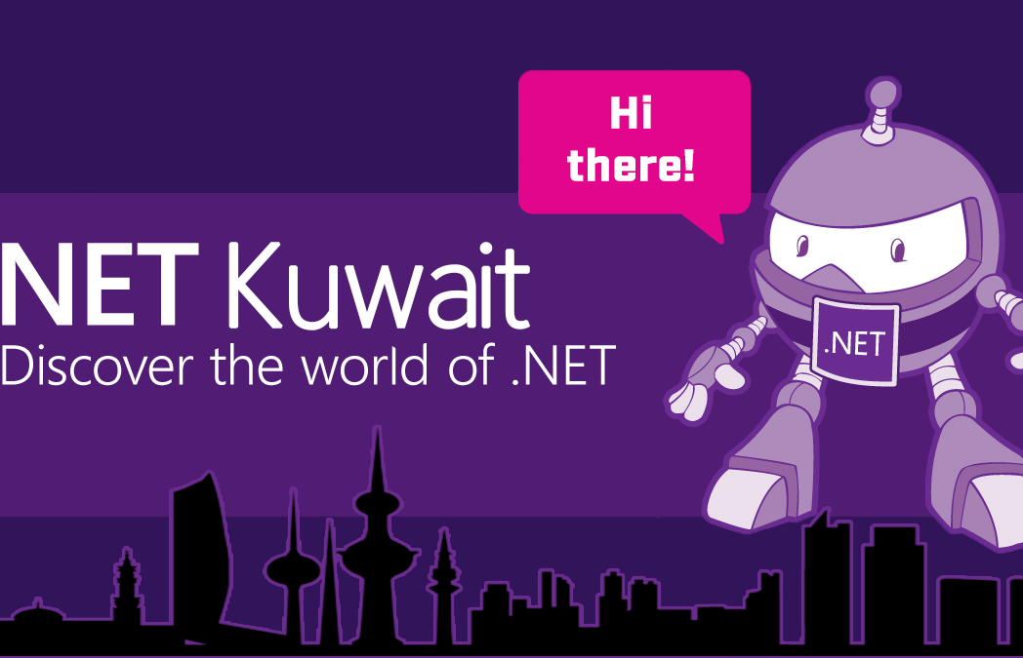
Migrate Web App to Azure.

Slide 2
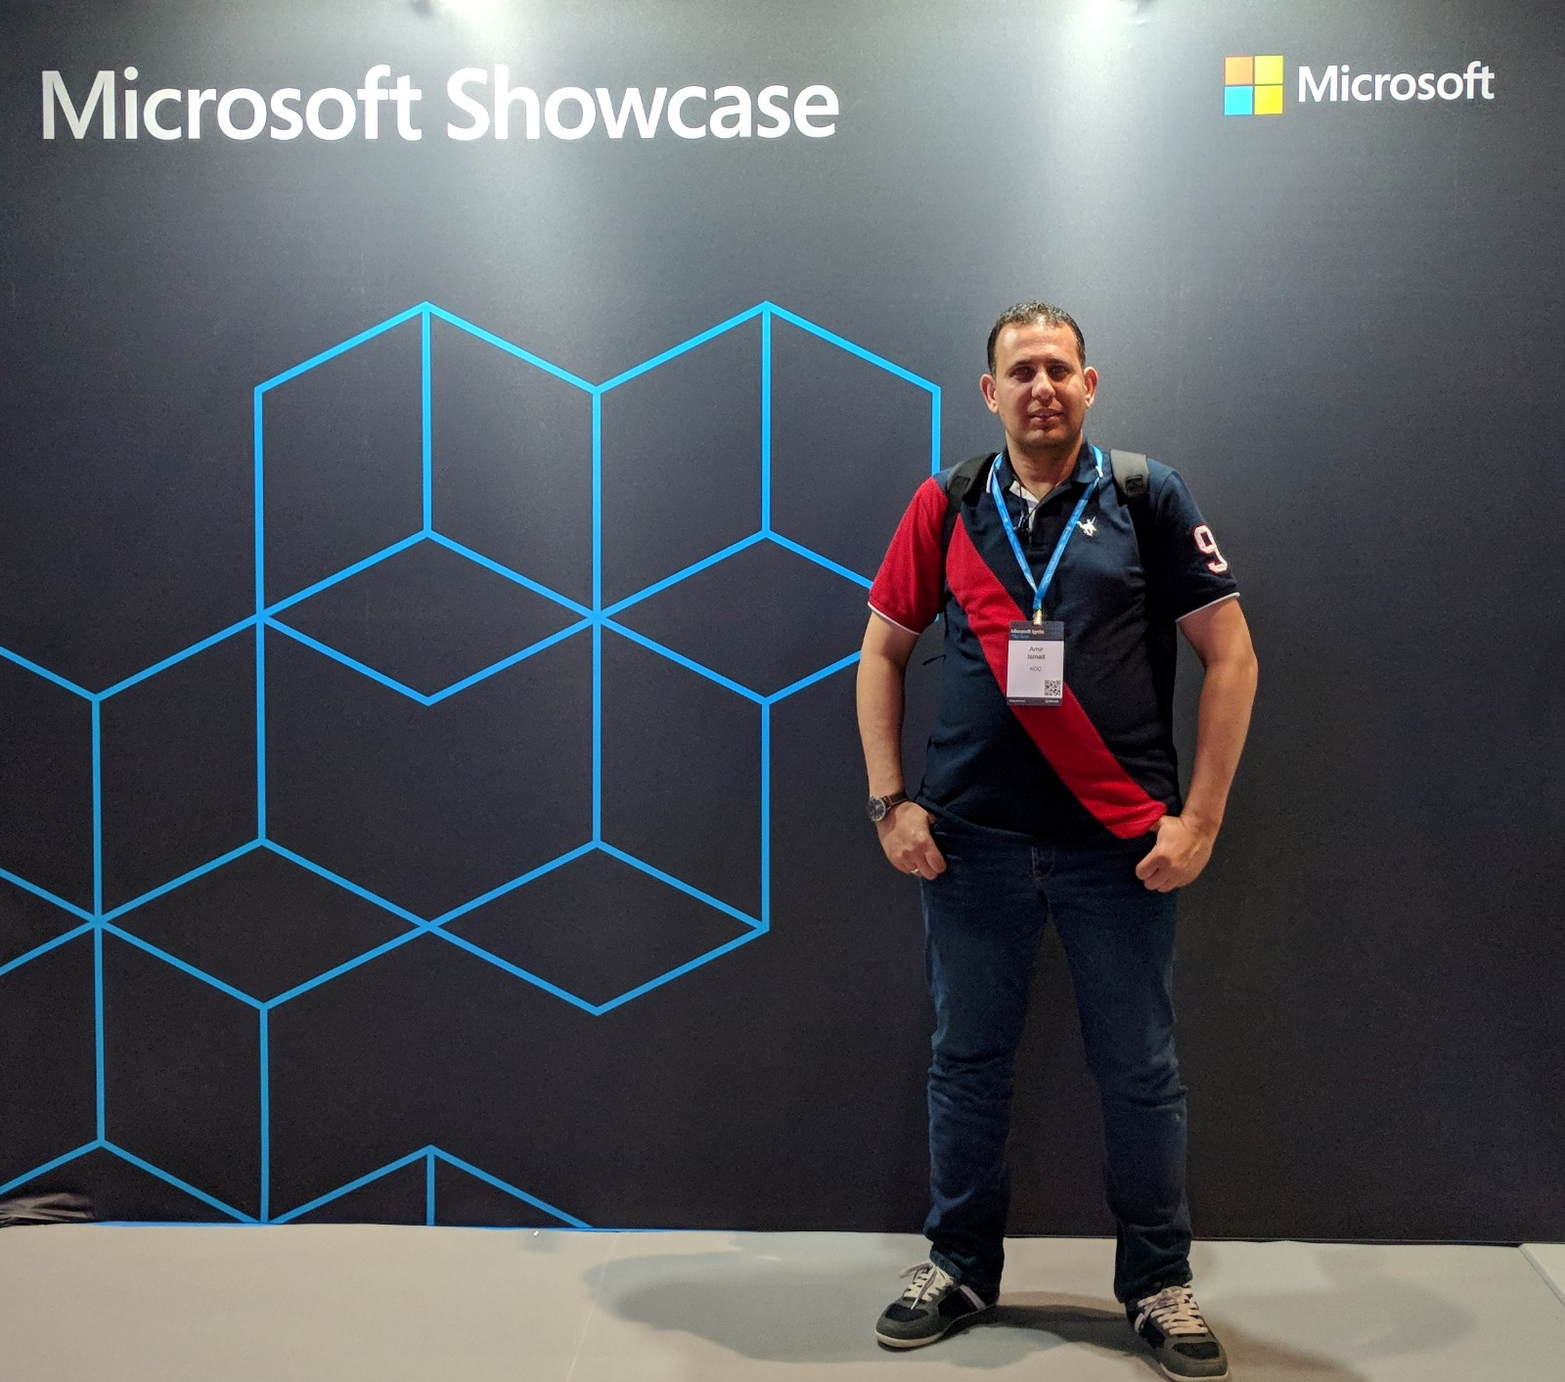


Amir Ismail
Overview
Senior Software Engineer for Kuwait Oil Company.
+15 years of experience in Software Engineering. I participated in multiple projects in different business domains range from E-learning, Banking, Oil, E-booing and Hotels management.
Certifications
PSM I Certified.
ITIL® Certified.
PRINCE2® Certified.
Contact Details
@Miroprocessor
https://www.linkedin.com/in/amirismailyousef/

Slide 3
What is cloud computing?
Cloud computing is renting resources.
Cloud provider is responsible for the physical hardware required.
The computing services offered by cloud provider typically include
Compute power - such as Linux servers or web applications
Storage - such as files and databases
Networking - such as secure connections between the cloud provider and your company
Analytics - such as visualizing telemetry and performance data

Slide 4
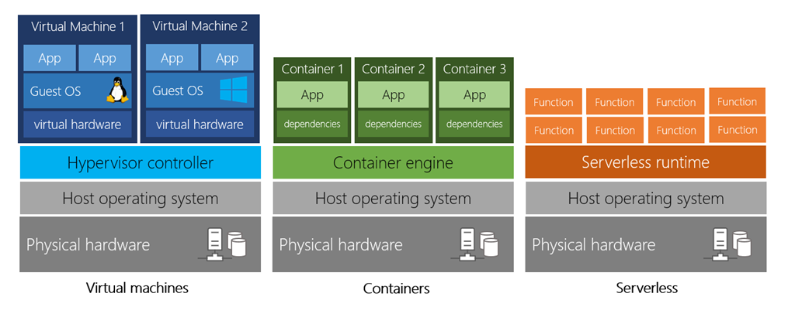
Types of Compute Power
Virtual Machines – VMs
Like a physical computer, includes operating system and hardware.
You can Install whatever software you want.
Gives more control over and responsibilities over maintenance.

Slide 5
Types of Compute Power
Containers (ex: Docker)
provide a consistent, isolated execution environment for applications.
similar to VMs except they don't require a guest operating system(no boot time).
the application and all its dependencies is packaged into a "container" and then a standard runtime environment is used to execute the app.

Slide 6
Types of Compute Power
Serverless Computing
run application code without creating, configuring, or maintaining a server.
you only pay for the processing time used by each function as it executes

Slide 7
Benefits of cloud computing
Cost effective – pay as you go.
No upfront infrastructure costs.
No need to purchase infrastructure may not be used.
The ability to pay for additionally resources when they are needed.
The ability to stop paying for resources that are no longer needed.
Scalability
It can be done manually or automatically based on specific triggers.
Vertical Scaling(scaling up)
adding more resources to the existing server(VM).
Horizontal Scaling(scaling out)
adding more servers(VMs) that function together as one unit.
Elasticity
As your workload changes due to a spike or drop in demand, a cloud computing system can compensate by automatically adding or removing resources

Slide 8
Benefits of cloud computing
Current
Focus on building and deploying applications.
Use the latest software and tools.
Maintaining software patches, hardware setup, upgrades automatically done for.
Reliable
Your data is always going to be there.
Azure offers data backup, disaster recovery, and data replication services
Redundancy is built into cloud services architecture so if one component fails, a backup component takes its place.
Global
Azure has fully redundant datacenters around the globe in different regions.
Secure
Azure is secured with multi-levels of security starting from physical security for accessing data centers building to encrypting your data and files.

Slide 9
Cloud Deployment Models
Public
You have no local hardware
Cloud provider is managing and maintaining your resources.
Ex.: Azure, WAS, and google cloud.
Private
Your create your own cloud environment in you datacenter.
Your are responsible for managing and maintaining hardware and security.
Hybrid
It combines the public and private clouds.
Allows you run your application in most appropriate location.
Each model has its own pros and cons. The selection is based on your business requirement and restrictions.

Slide 10
Types of cloud services
Infrastructure as a Service(IaaS)
It provides the hardware and operating system. It can be used in
Migrating work loads.
Test and development.
Storage, backup, and recovery.
Platform as a Service(PaaS)
Its goal is helping you create an application quickly without managing the underlying infrastructure. It is commonly used in following scenarios
Development Framework.
Analytics or business intelligence.
Software as a Service(SaaS)
It is centrally hosted and managed for end user like Dynamics CRM, Skype, and office 365 .

Slide 11
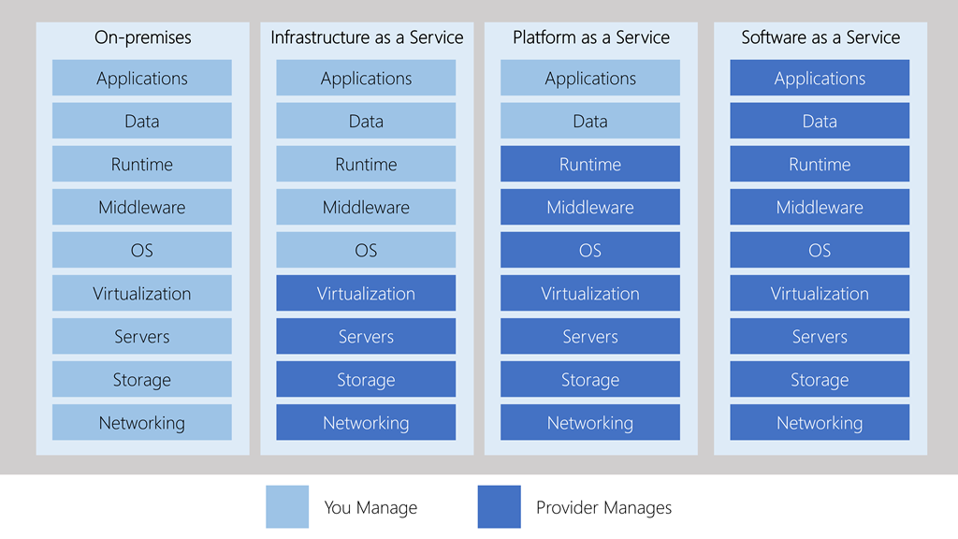
Types of cloud services – Management Responsibilities

Slide 12
Types of Azure Data Storage
Structured Data (relational data)
Adheres to a schema, so all of the data has the same fields or properties.
Can be stored in a database table with row and columns.
Easy to enter, query, and analyze.
All data follows the same format.
Semi-Structured data (non-relational or NoSQL)
Uses tags or Keys instead of tables, rows and columns .
Tags or keys are organized in a hierarchy (Documents).
Unstructured Data
Has no designated structure.
No restrictions on the kind of data it can hold.
Becoming more prominent as business try to tap to a new data source.
Ex: PDFs, media files, JSON files.

Slide 13
Benefits of Using Azure Data Storage
Automated backup and recovery
Replication across the globe
Copies your data to protect it against planned or unplanned events.
Able to choose replicate your data at multiple locations across the globe.
Support for data analytics
Statistics about your data consumption.
Encryption capabilities
Data is encrypted by default
You have control over who can access your data
Multiple data types
Data storage in Virtual disks
You can store up to 8 TB in Azure virtual disk.
Storage tiers
Tiers to prioritize access to data based on frequently used versus rarely used.

Slide 14
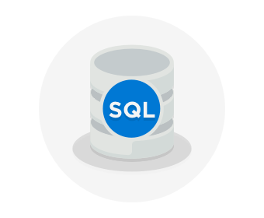
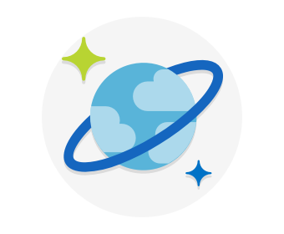

Azure Data Storage Options
Azure SQL Database
Relational database as a service (DaaS).
Latest stable version of MS SQL Server.
Migrate existing DBs to Azure SQL using Azure database Migration Service.
Microsoft Data Migration Assistant generate recommendation report.
Just change the connection string in your Application.
Azure CosmosDB
Distributed database service.
Supports schema-less (NoSQL) data.
Azure Blob Storage
Unstructured which means no restriction on the kind of data.
Highly scalable.
Reached from anywhere.
Ability to store up to 8 TB of data for virtual machines.

Slide 15
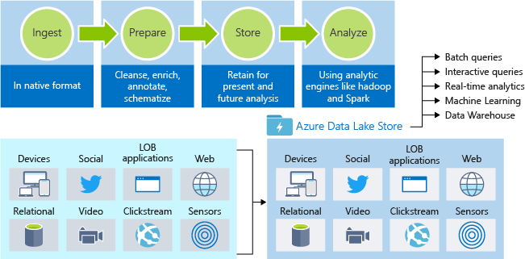
Azure Data Storage Options
Azure Data Lake Storage
Allows to you to perform on your data usage and prepare reports.
Large repository stores structured and unstructured data.
Combines scalability and cost effective of object storage with the performance and reliability of Big Data file system.

Slide 16
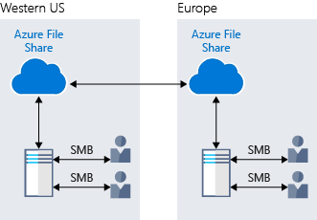
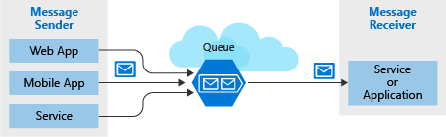
Azure Data Storage Options
Azure Files
Fully managed file shares accessible via Server Message Block(SMP) protocol.
Any number of azure virtual machines or roles can mount and access the
file storage share simultaneously.
Azure Queue
It is a service for storing large number of messages that be accessed from anywhere.
Provides asynchronous message queueing for communication
between application components.
One or more message sender and one or more message receivers.
Sender add message to queue and receiver retrieve the message from
the front of queue.

Slide 17
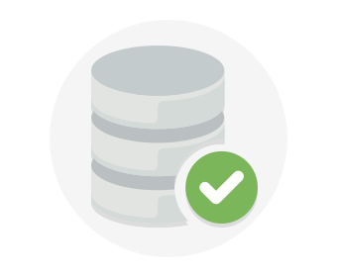
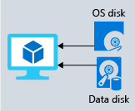
Azure Data Storage Options
Disk Storage
Provides disks for virtual machines and applications to access and use as they need.
Allows data to be stored and accessed from the attached virtual hard disk.
Disks can be managed by azure and managed and configured by user.
Used in lift and shift scenarios or for storing data that is not accessed from outside
the virtual machine.
Different sizes and type (SSD & HDD)

Slide 18
Azure Storage Tiers
Hot Storage Tier
Storing data that is accessed frequently.
Cool Storage Tier
for data that are infrequently accessed and stored for at least 30 days.
Archive Storage Tier
for data that are rarely accessed and stored for at least 180 days with flexible latency requirements.

Slide 19
Encryption for Azure Storage
Azure Storage Service Encryption(SSE)
Azure encrypt the data before storing it and decrypt the data before retrieving it.
Encryption and decryption are transparent to the user.
Client Side encryption
Data is encrypted by client.
Azure store encrypted data as it is.
Azure decrypts the data during retrieval.

Slide 20
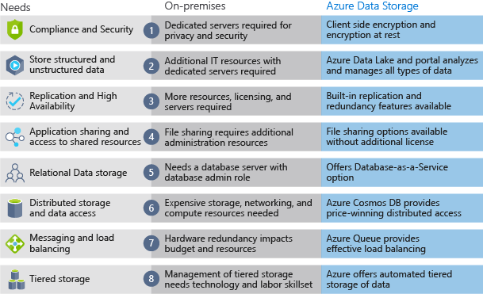
On-Premises vs Azure Storage
Cost Effectiveness
Reliability
Storage Types
Agility

Slide 21
Migrating Web App to Azure.
Create an account on Azure(SKIP)
Create a subscription(SKIP)
Create a resource group - logical group
Managed by Azure Resource Manager (ARM)
Create a VM.
Create an App Service.
Create a website hosted in Azure
Storage

Slide 22
DEMO

Slide 23



Contact Us
@dotnetkw
@dotnetkw
.Net Kuwait

Slide 24
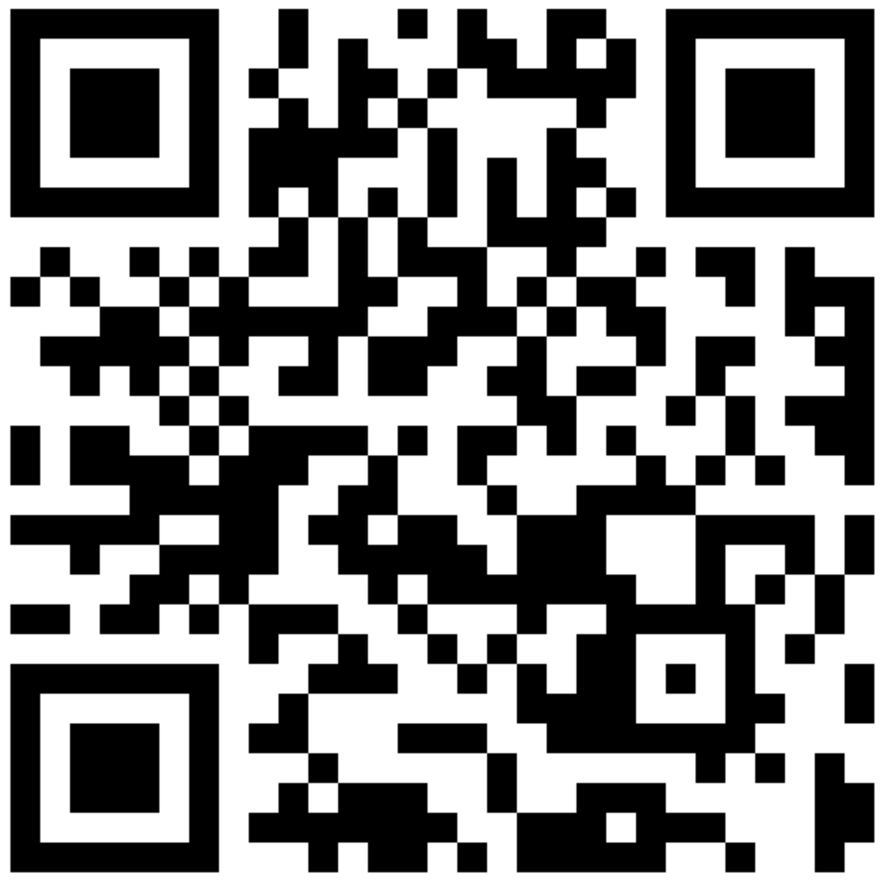
SCAN THE CODE & START YOUR JOURNEY ON .NET today!
https://aka.ms/AA62x0i

Slide 25
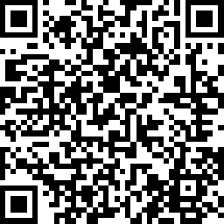
SCAN THE CODE & SEND US YOUR FEEDBACK!
https://www.surveymonkey.com/r/GK96HDK

Slide 26
Thank You

